Slide 1


Viva Connections & SharePoint Framework Bi-weekly sync
aka.ms/m365pnp
We ❤ Patrick
Patrick
September 8th, 2022
Microsoft 365 PnP Team
Well, not retirement, but you know what we mean. We’ll miss you!

Slide 2




Agenda
Latest update on the SharePoint Framework
Patterns and Practices Updates
PnPjs
CLI for Microsoft 365
Reusable PnP SPFx controls
New Community Samples
Picture time with Together Mode!
Demos
Ejaz Hussain – Getting started with SPFx form customizer
Hugo Bernier – Building SPFx solution with Azure Communication Services integration

Slide 3
Opportunities to Participate in PnP SPFx / JS SIG
SPFx Demo
@pnp Demo
Contribute on GitHub
Provide Feedback
Web Part
Application Customizer
Provisioning
Anything you create!
PnPjs
CLI for Microsoft 365
SPFx Reusable Controls
SPFx Community Yeoman
Report Issues
Submit Pull Requests
Help with issues/questions
How are the calls?
Documentation needs?
Where can we help?
Positive is OK too!
Great opportunity to get visibility for you or your company. Demo sample or explain how you extend or customize SharePoint Online with live demo in your projects. Reach out to team for volunteering.
Request a demo spot on the call
https://aka.ms/m365pnp/request/demo

Slide 4
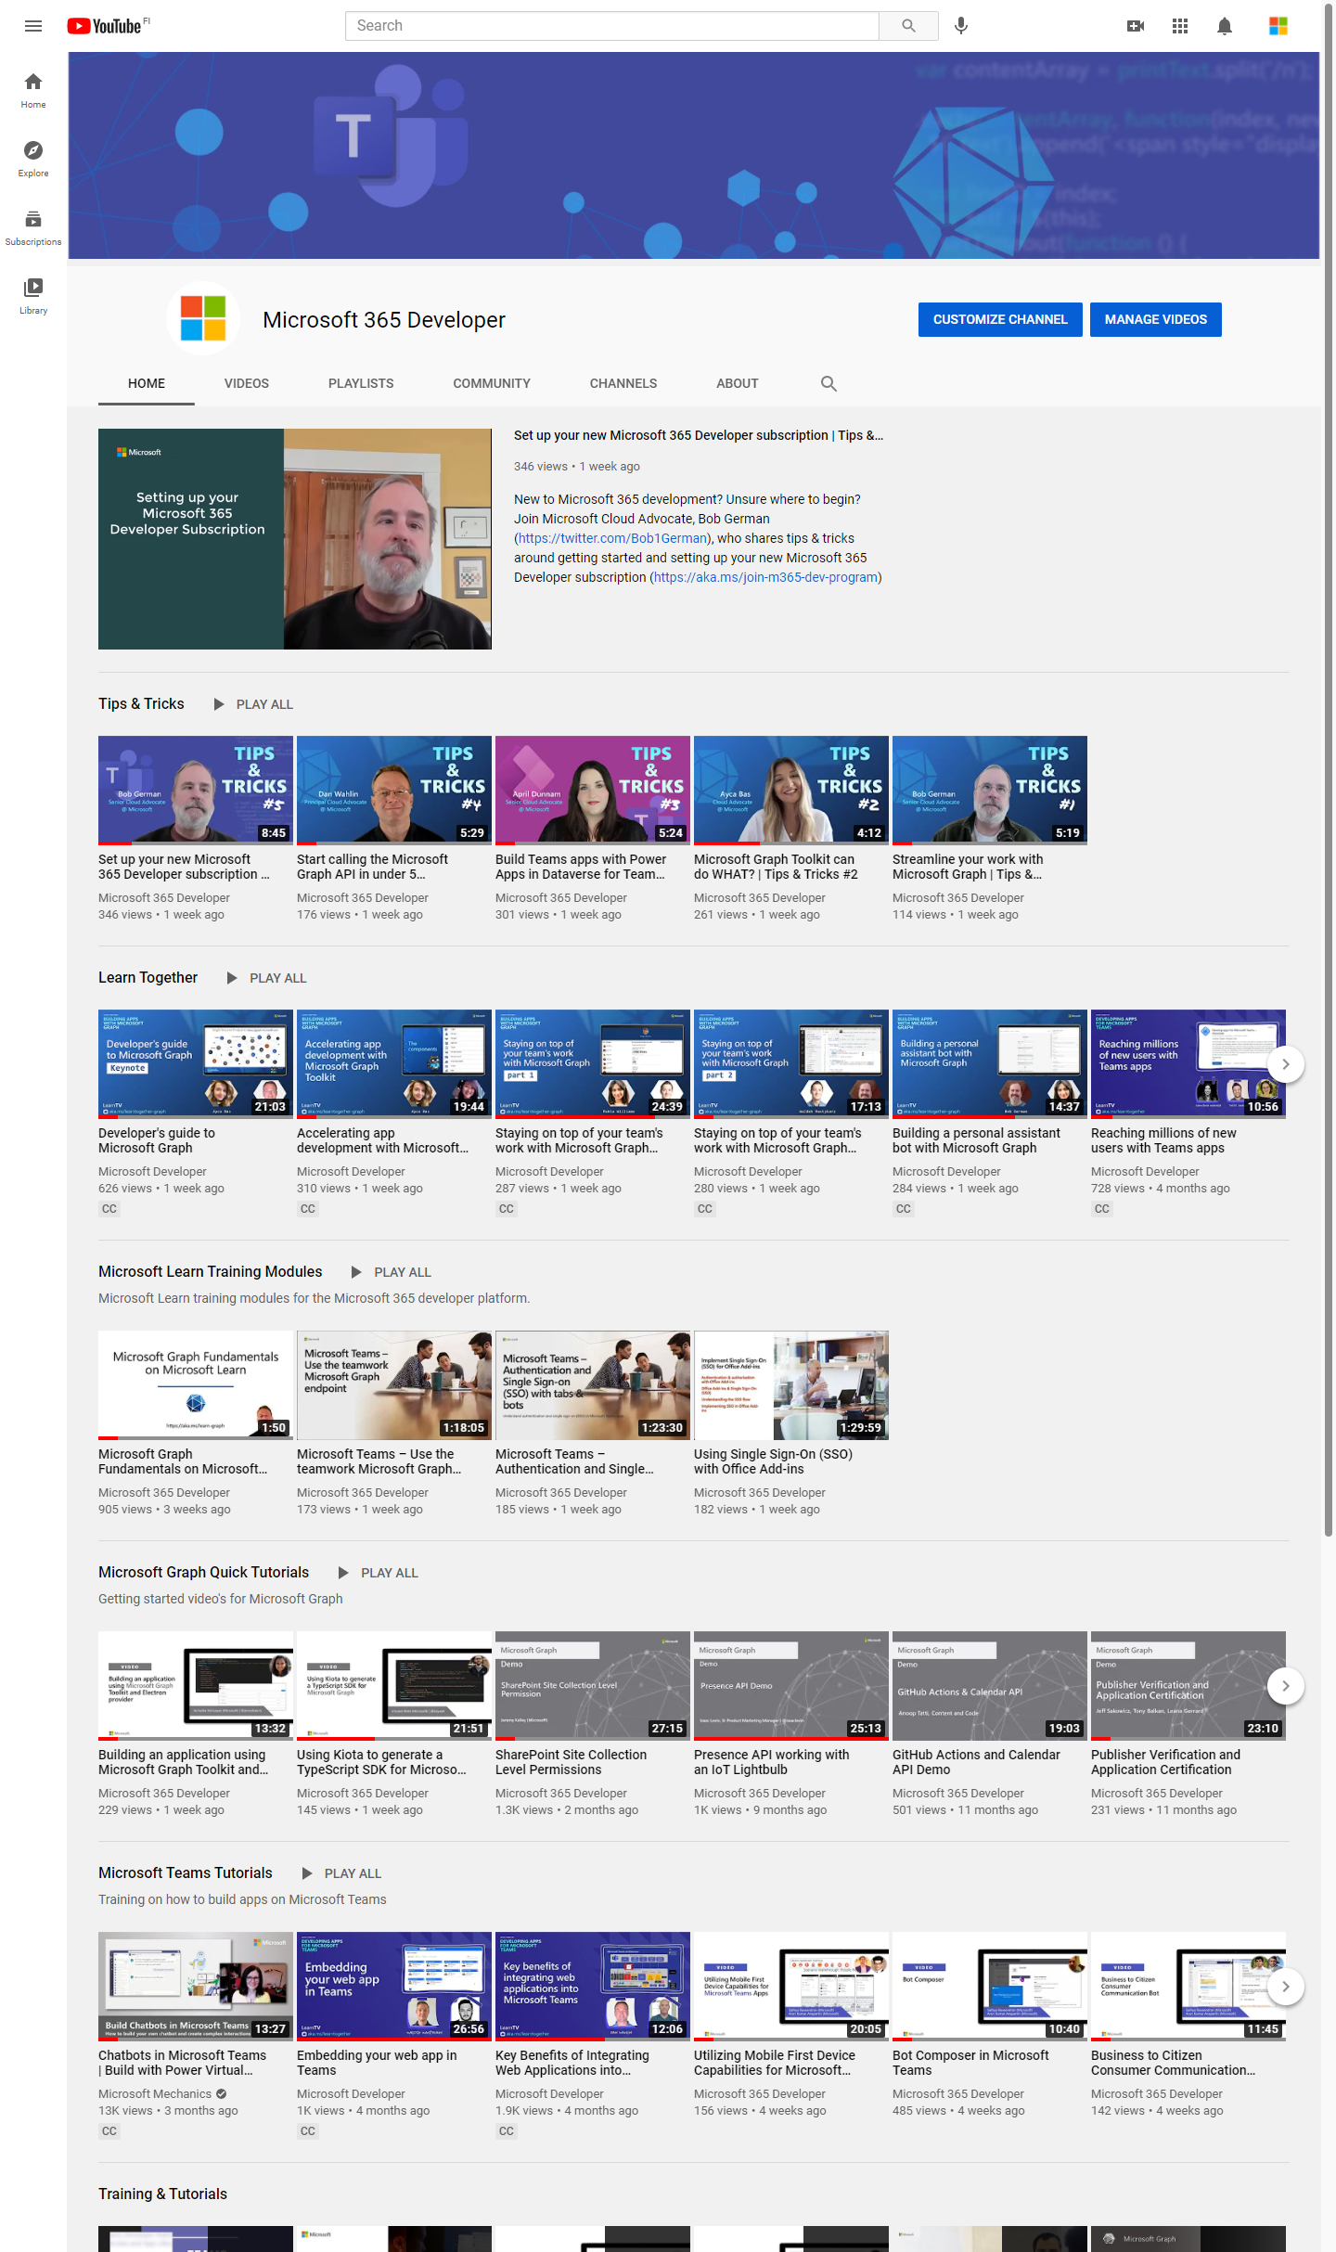
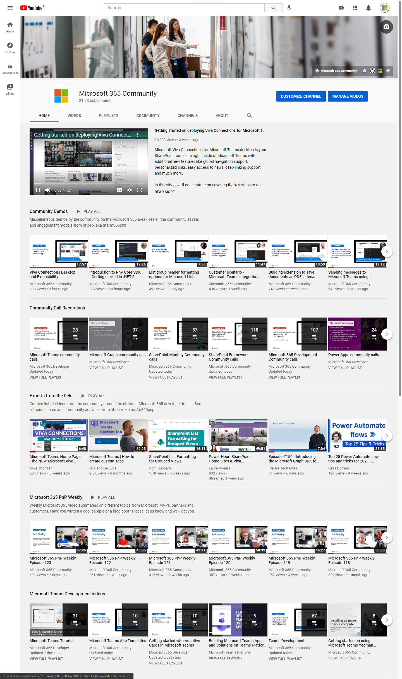
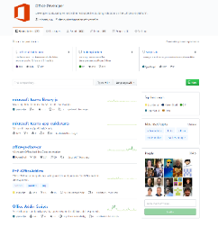
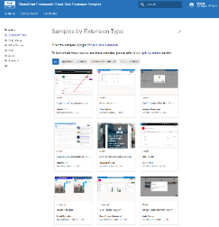
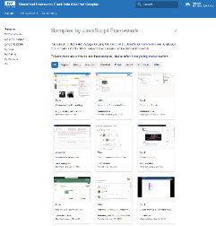
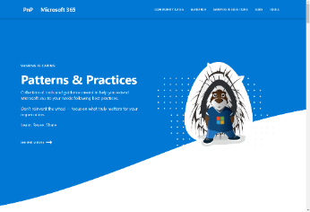
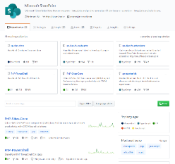
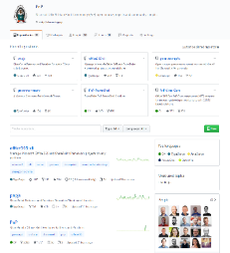
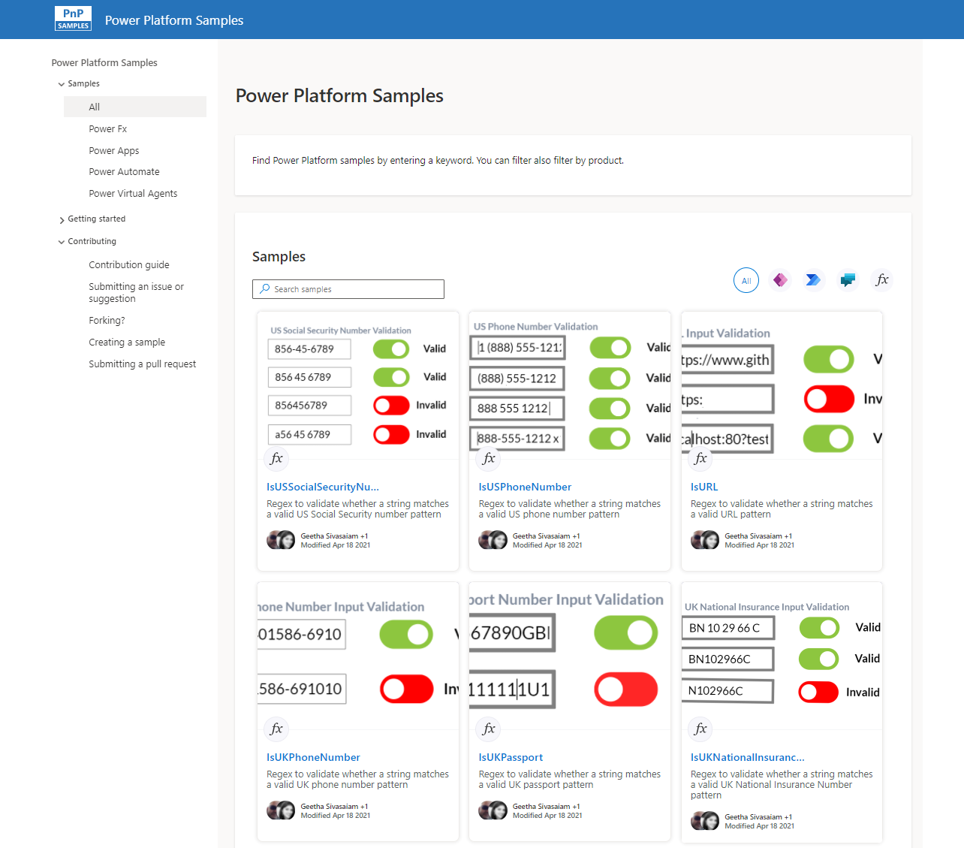
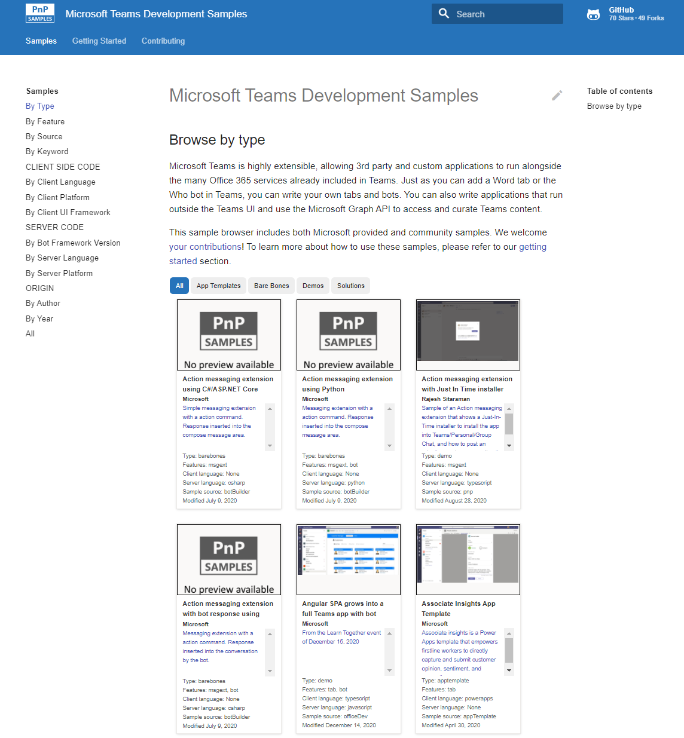
Microsoft 365 developer videos
Microsoft 365 community videos
Open-source
Sample galleries
Open-source initiatives and samples
aka.ms/m365devyoutube
aka.ms/m365/videos
github.com/pnp
github.com/officedev
github.com/microsoftgraph
github.com/sharepoint
github.com/OneDrive
aka.ms/m365/samples
aka.ms/teams-samples
aka.ms/spfx-webparts
aka.ms/spfx-aces
aka.ms/powerplatform-samples
aka.ms/spfx-extensions
aka.ms/list-formatting
aka.ms/m365/community
@Microsoft365Dev | @m365pnp
One URL to rule them all…

Slide 5
Microsoft 365 developer community calls
Microsoft 365 platform (weekly) https://aka.ms/m365-dev-call
(Notice. This call is on a summer break between July 1st and 31st of August 2022 – back on 6th of September)
Adaptive Cards https://aka.ms/adaptivecardscommunitycall
Microsoft identity platform https://aka.ms/IDDevCommunityCalendar
Office Add-ins https://aka.ms/officeaddinscommunitycall
Power Platform https://aka.ms/PowerPlatformCommunityCall
Microsoft 365 and Power Platform community (bi-weekly) https://aka.ms/m365-dev-sig
Viva Connections & SharePoint Framework (bi-weekly) https://aka.ms/spfx-call
Download recurrent invites from
https://aka.ms/m365/calls
Notes:
m365-dev-sig

Slide 6
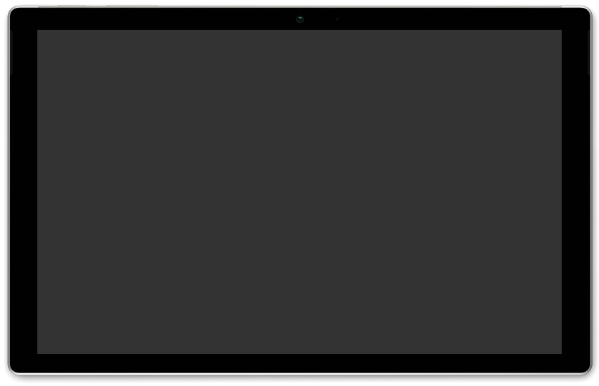


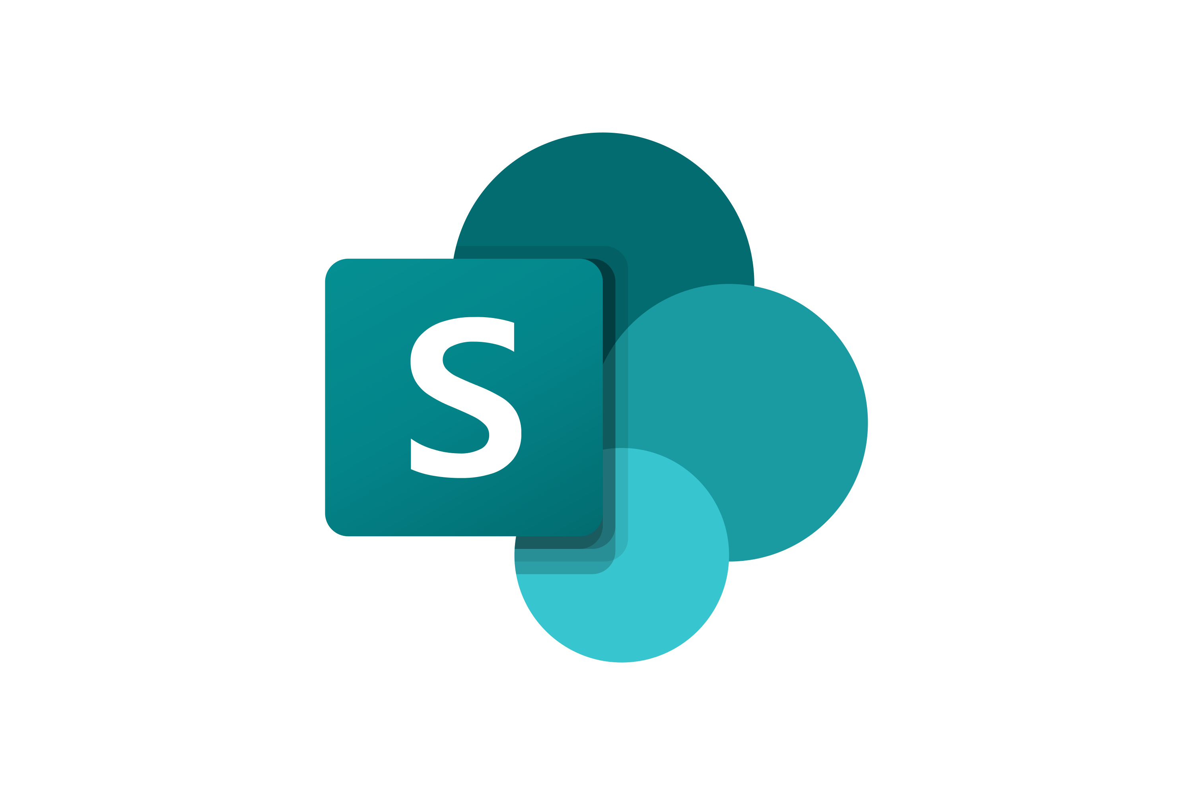



Latest news from Microsoft engineering on Microsoft 365 topics
Monthly community contributors
Community together mode group photo
Rabeb Othmani - Microsoft Graph Postman - Scripts and advanced functionality
Ayca Bas - Build productivity tabs with Microsoft Teams Toolkit for Visual Studio
Bob German - Introduction to app camp
AGENDA
Microsoft 365 platform call 13th of September @ 8 AM PT
Weekly call with Microsoft presenters covering the latest Microsoft 365 platform updates
Download recurrent invite from https://aka.ms/m365-dev-call
Notes:
Dan’s slide

Slide 7
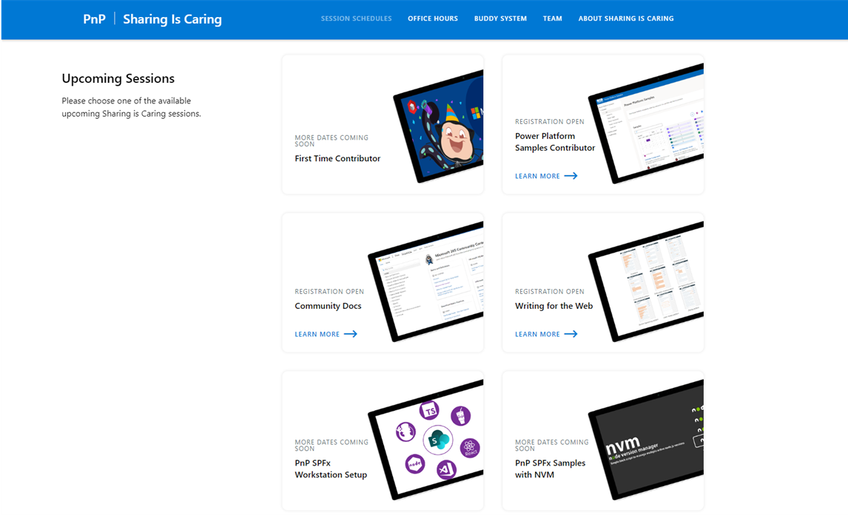
GUIDANCE
Learn how to get started in the open-source PnP community!
Upcoming Sessions:
First-time contributor
Community docs
Writing for the Web
Using PnP SPFx samples w/ NVM
SPFx developer workstation setup
More than code with VS Code
First-time presenter
M365 Maturity Model Practitioners
Power Platform Samples Contributor
Power Platform Conference Session
https://aka.ms/sharing-is-caring
Notes:
25 Total attendees, 16 attendees who attended both First-Time Contributors and Community Docs sessions.

Slide 8





COMMUNITY
Recognition Program
Showcase your contributions
Powered by Credly
More achievement levels coming soon
https://aka.ms/m365pnp-recognition
Notes:
25 Total attendees, 16 attendees who attended both First-Time Contributors and Community Docs sessions.

Slide 9
SharePoint Framework Latest from Microsoft engineering for Microsoft Viva, Microsoft Teams and SharePoint extensibility

Slide 10
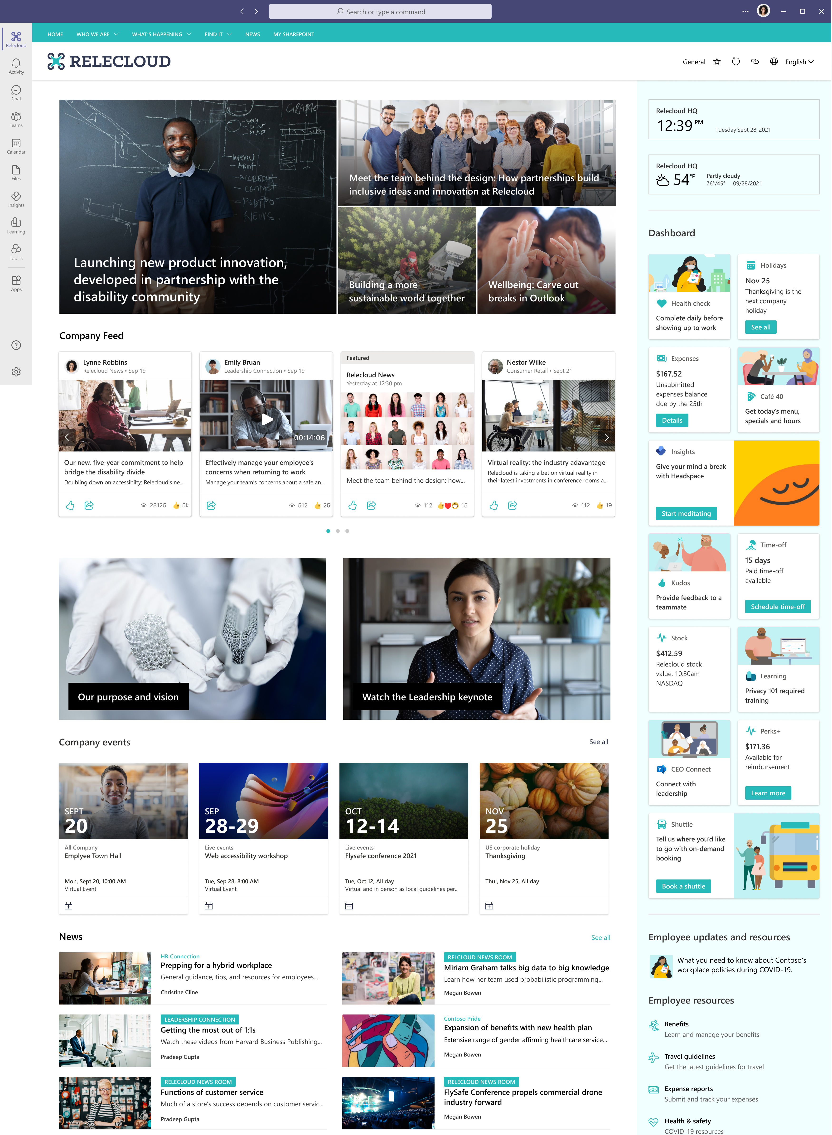
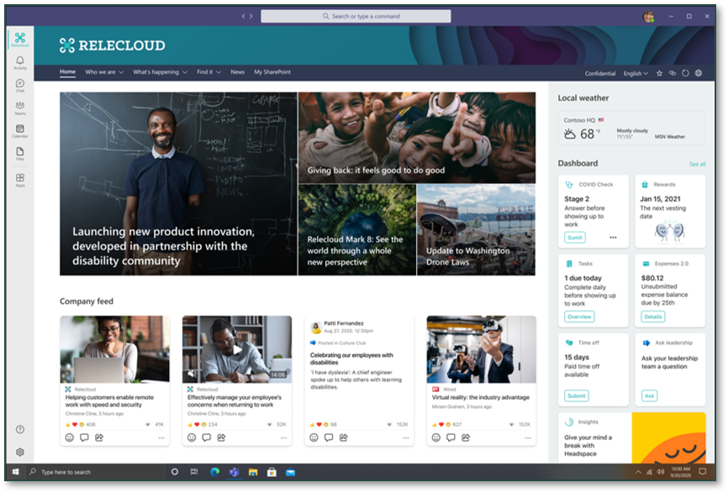
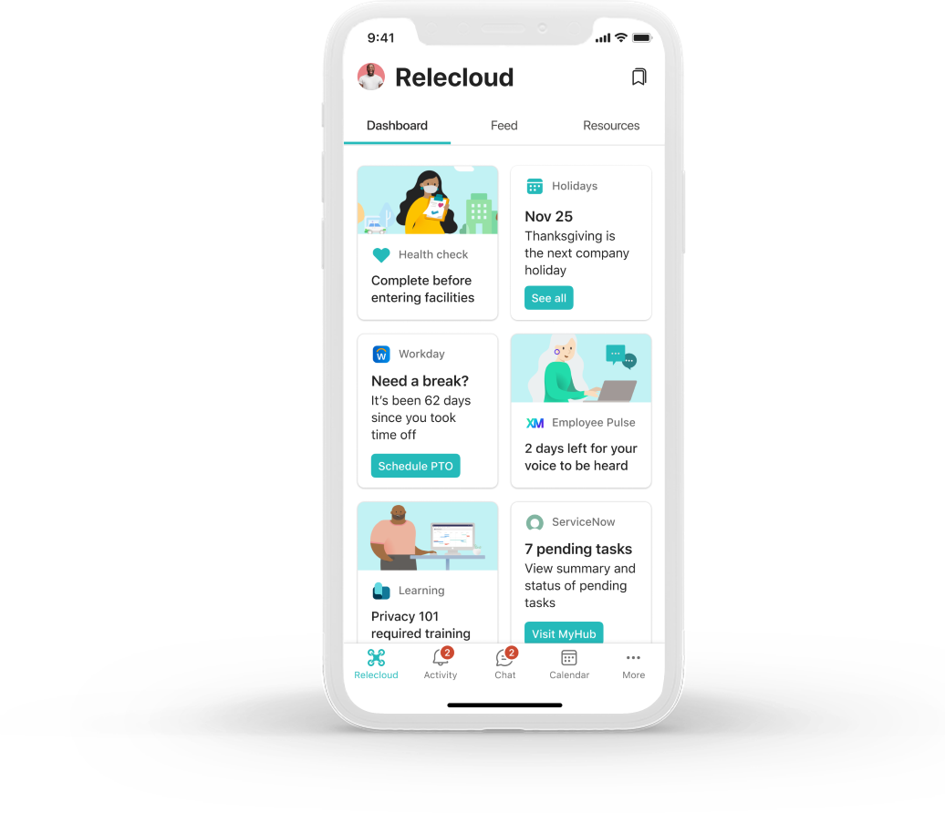
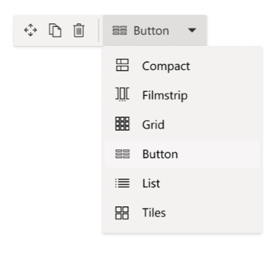
PREVIEW
SharePoint Framework 1.16 public developer preview!
Preview on the upcoming SharePoint Framework version now available with updated features for Microsoft Teams, Microsoft Viva and SharePoint Online
npm install -g @microsoft/generator-sharepoint@next
Notes:
Dan’s slide

Slide 11
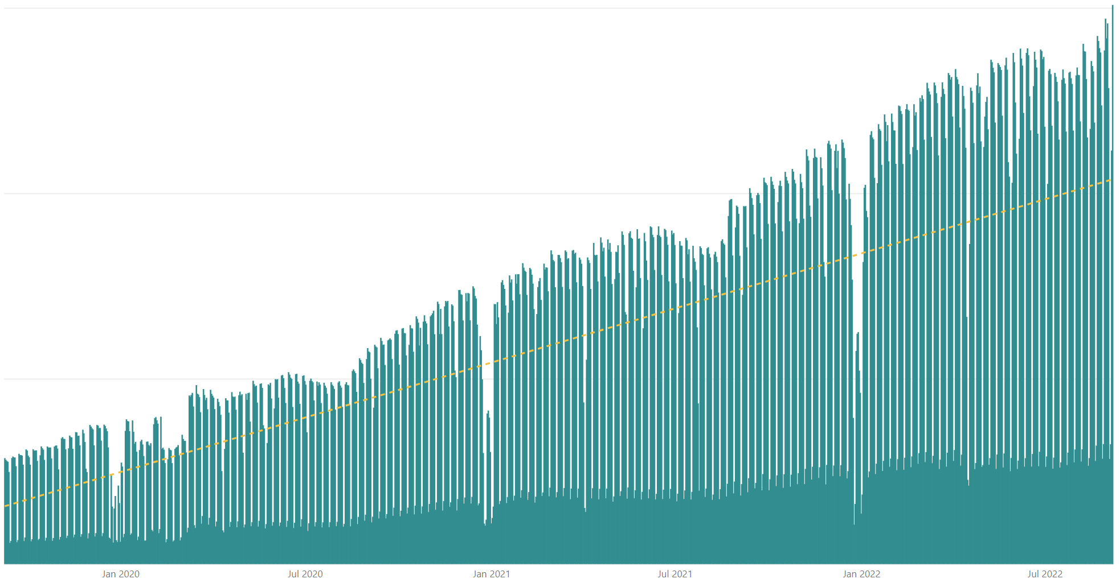

Rolling 28 days active users (MAU) for custom SharePoint Framework components in M365 There are currently tens of millions of monthly active users for customer and partner created SharePoint Framework components in Microsoft 365
All time highest usage in a day – Tuesday 6th of September 2022
Jan 2020
Jul 2020
Jan 2021
Jul 2021
Jan 2022
Jul 2022

Slide 12



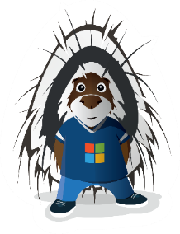
The Road Ahead – SPFx roadmap
1.15.2 – Released in August – latest in prod version
Enable Service Principal Registration in app acquisition flow
New media action type for Viva Connections
ESLint support update based on community feedback
Bug fixes and adjustments based on GitHub issues
1.16 preview released week ago
Teams JavaScript SDK v2 native support in SPFx solutions – rolling out also to existing solution
Asynchronous support for Viva Connections ACEs rendering
New Top Actions support for web parts - Top Actions allow developers to add custom actions to web part's command bar. The feature is like property pane controls but based on cleaner UI approach.
… and more… 🚀
1.16 General Availability in by end of 2022
1.17 ETA in December/January
and more across Microsoft Viva, Microsoft Teams and SharePoint

Slide 13

PnPjs Client-Side Libraries

Slide 14























PnPjs Client-Side Libraries
Version 3.7 to be released Sept 9th
General documentation updates
Support for SP favorites (thank you Konrad K.)
$search & $filter parameters on Graph pages behavior
Ability to rate and item in SP (1-5)
More improvements for query escaping
Enhancements to copyByPath and moveByPath
Added ACS auth behavior recipe
Don’t forget about the nightly builds
npm install @pnp/sp@v3nightly --save
Docs: https://pnp.github.io/pnpjs/ @m365pnpjs on twitter

Slide 15
CLI for Microsoft 365

Slide 16
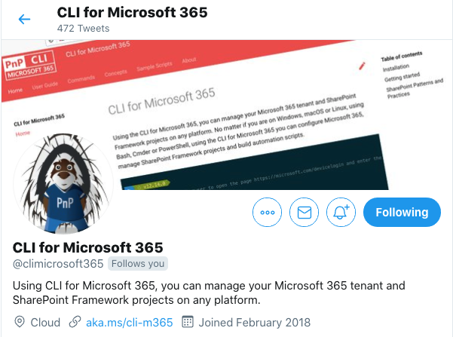
CLI for Microsoft 365
New release 5.7 with:
Support for retrieving Microsoft Bookings
Support for granting admin consent for AAD apps
Support for resetting role inheritance on SharePoint webs
Support for managing role assignments on SharePoint lists
Support for removing Microsoft Search external connection
Support for upgrading SPFx projects to v1.15.2
And more...
Install and run 5.7 release:
npm install -g @pnp/cli-microsoft365@latest
docker run --rm –it m365pnp/cli-microsoft365:latest
Release notes:
https://pnp.github.io/cli-microsoft365/about/release-notes/
V6
ETA November ‘22
@climicrosoft365 #CLIMicrosoft365 on Twitter
📖 aka.ms/cli-m365
🗣 github.com/pnp/cli-microsoft365/discussions
Notes:
Introduce yourself - "Hey everyone 👋 Its Garry here from the CLI team"
High level - ”It’s a new month, so we've just released the next latest version of the CLI, v5.7"
Summary - "In this release we have new commands and enhancements across Azure Active Directory, Microsoft Bookings, SharePoint Online, Microsoft Search and SharePoint Framework, plus general improvements and bug fixes."
CTA (engage) - "I have provided some links in the chat for you to access all the key resources surrounding this release"
CTA (check docs) - ”Please checkout the release announcement, which include examples of how to use some of the new features and also the release notes for further detail on what has included in this release"
CTA (install) - "If you want to use the latest version, you can install directly from npm, or alternatively use our Docker image to run CLI in a container using the latest tag"
CTA (follow us) - "If you want to keep up with the latest CLI announcements, I highly recommend that you can follow our Twitter account @climicrosoft365"
CTA (feedback) - "If you have any feedback (both positive and negative) or ideas for new features that you'd like to see, then please checkout the GitHub repo, and either raise an issue or start a discussion, we would absolutely love to hear from you”
We have open discussions on commands to manage comments on pages/list item, file versions and document sets. We have a few new Power Platform related commands that have been added to the issues list, so if those interest you we would love to know your thoughts.
Latest beta has new commands for executing web requests, retrieving onenote notebooks and further enhancements for managing role assignments on webs and list item
Heads-up that we are also closing in the next major version of the CLI, which will be v6, we are aiming for release around November, we will be issuing upgrade guidance to help you make the jump from v5, as well as test it out before release.
Closing (Thank you) - "Finally, thank you to all the contributors who made this release possible. That’s all for now, thank you"
📣 CLI for Microsoft 365 v5.7 (pnp.github.io)
📝 Release notes - CLI for Microsoft 365 (pnp.github.io)
📦 @pnp/cli-microsoft365 - npm (npmjs.com)
🐳 Run CLI in a Docker Container - CLI for Microsoft 365 (pnp.github.io)
💬 CLI for Microsoft 365 (@climicrosoft365) / Twitter
💻 pnp/cli-microsoft365: Manage Microsoft 365 and SharePoint Framework projects on any platform (github.com)

Slide 17
SPFx Reusable Components

Slide 18
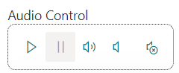
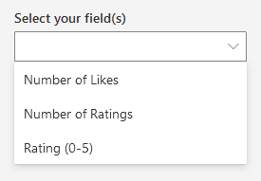
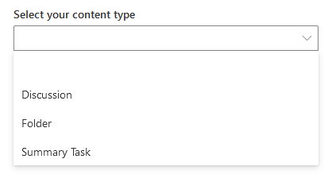
Reusable SPFx Controls
React Controls – 3.10.0
SPFx 1.15.2 support
ability to override field rendering for individual fields in Dynamic Form
Various fixes
Release notes: https://pnp.github.io/sp-dev-fx-controls-react/about/release-notes/
React Property Controls – 3.9.0
SPFx 1.15.2 support
Release notes: https://pnp.github.io/sp-dev-fx-property-controls/about/release-notes/
Special thanks to our contributors: Bart-Jan Dekker, Edin Kapic, Milan Holemans, Steve Beaugé.
More information:
https://sharepoint.github.io/sp-dev-fx-property-controls https://sharepoint.github.io/sp-dev-fx-controls-react
Twitter: @M365PnPControls

Slide 19
PnP Modern Search

Slide 20
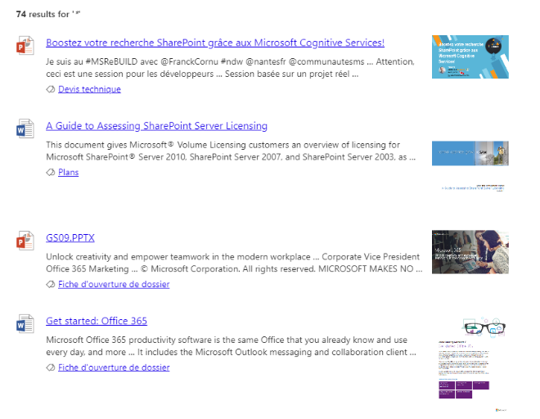

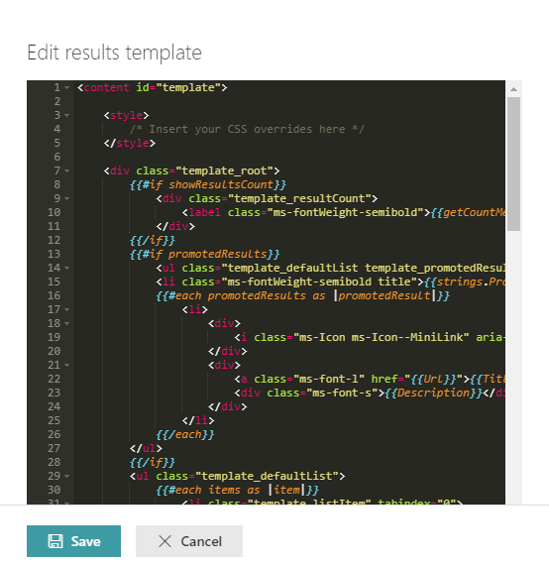
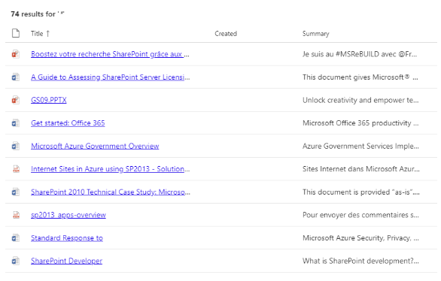

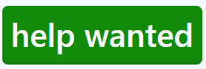
PnP Modern Search
http://aka.ms/pnp-search
Building modern Search experiences with flexible web parts
v4.7.0 – June 2022 release
https://github.com/microsoft-search/pnp-modern-search/releases/tag/4.7.0-beta
Thank you @d-martins, @bruzie, @rick-brown-slalom, @mrjarbenne, @davemehr for your support
Support for Adaptive Card rendering
See release notes for fixes and new features
v3.23.0 – December 2021 release
https://github.com/microsoft-search/pnp-modern-search/releases
See release notes for fixes and new features
Notes:
https://github.com/microsoft-search/pnp-modern-search

Slide 21

PnP SPFx Samples

Slide 22
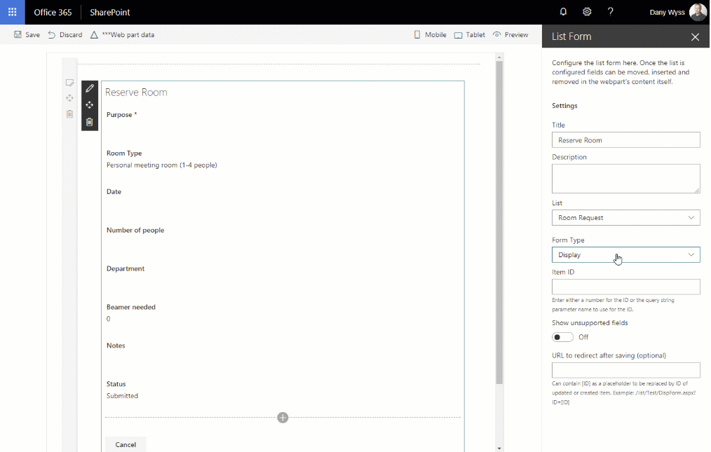
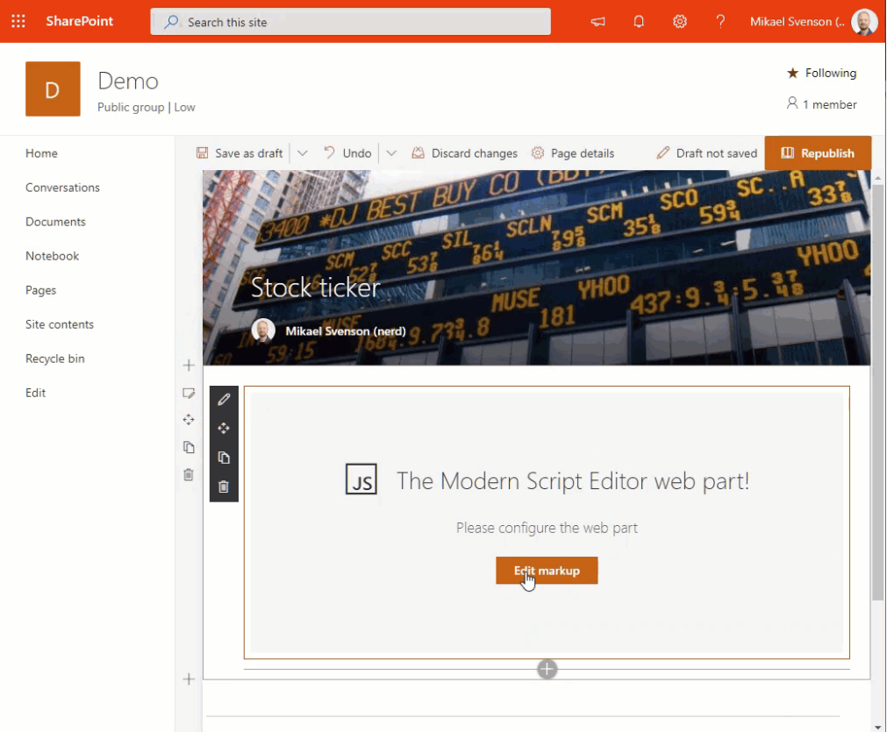
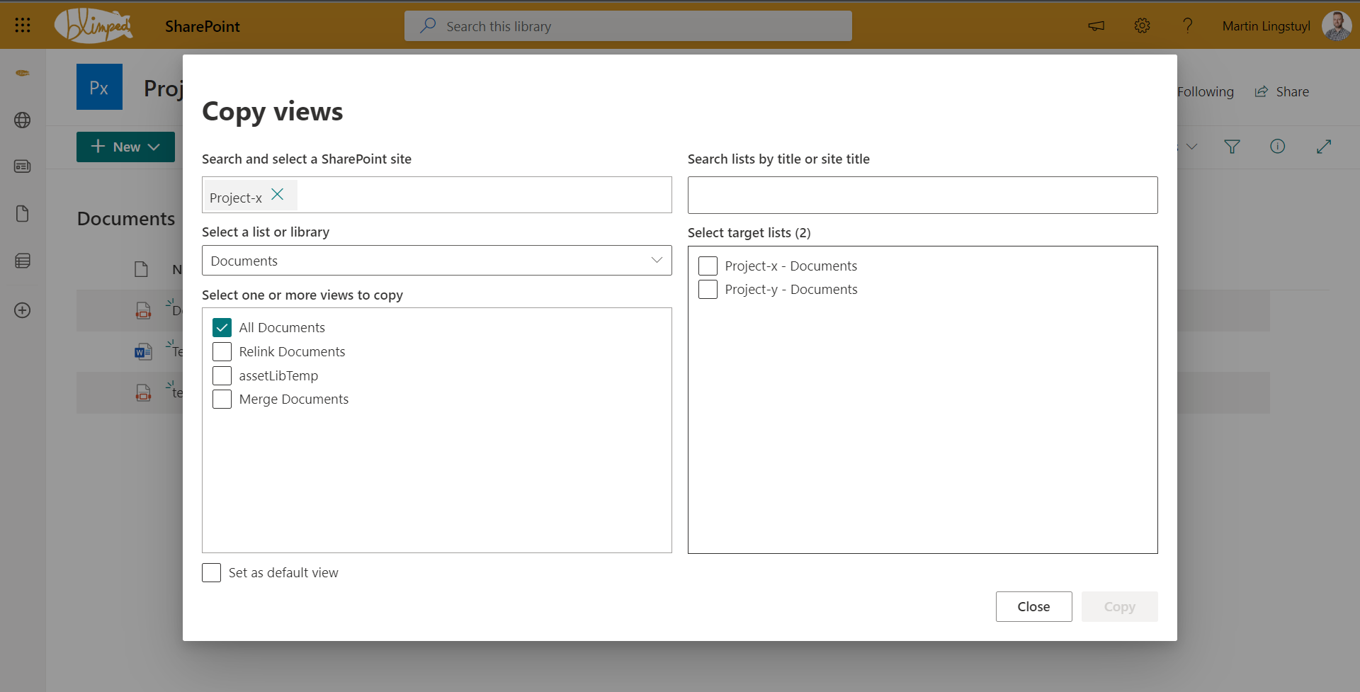
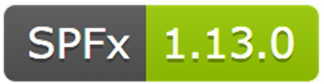
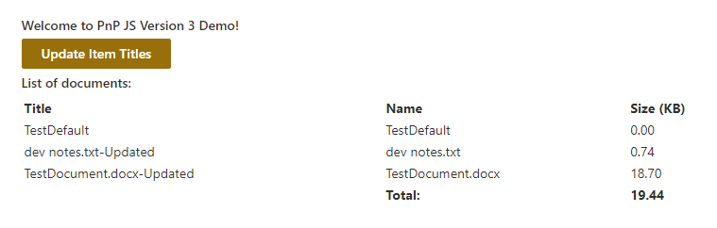
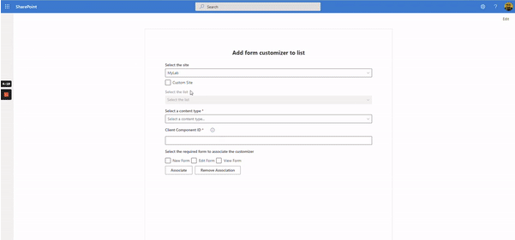
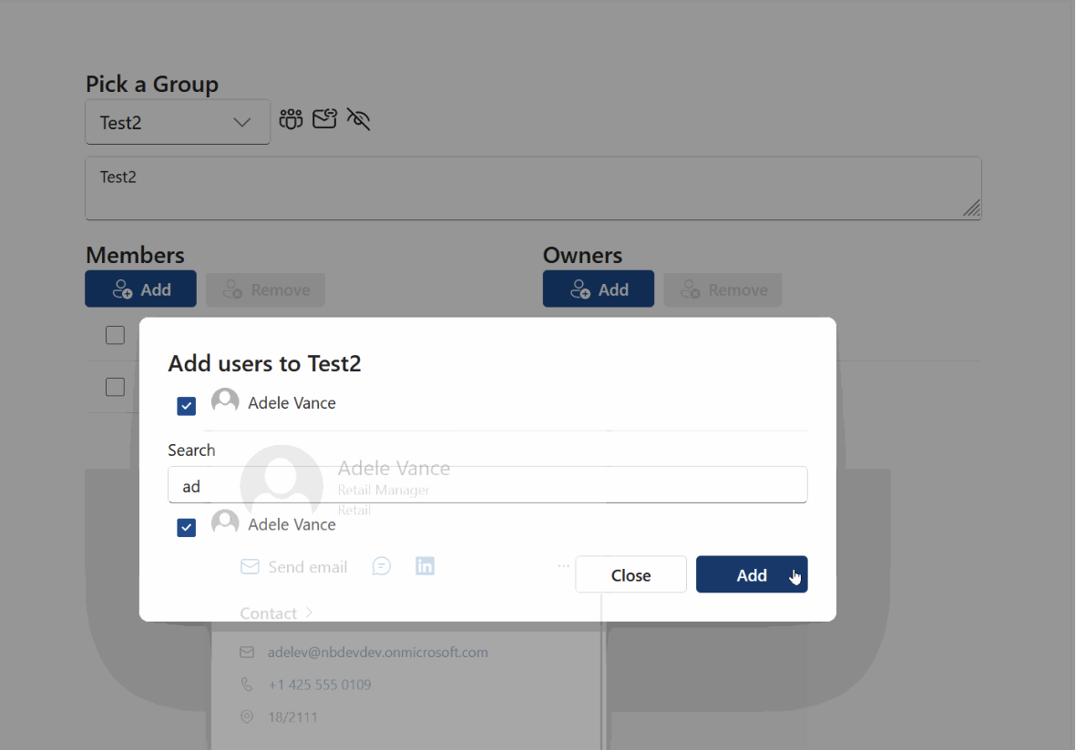
PnP SPFx Samples
PnP SPFx Samples
PnP SPFx Samples
https://aka.ms/spfx-extensions
https://aka.ms/spfx-webparts
List Form Rosa Alice | alicelupsan
Copy Views Martin Lingstuyl | @martinlingstuyl
Script Editor salascz
PnPjs Sample Julie Turner | @jfj1997
Group Membership Manager Nick Brown | @techienickb
Add Form Customizer to List Siddharth Vaghasia | @siddh_me
Follow Documents André Lage | @aaclage
Notes:
SPFx extensions https://aka.ms/spfx-extensions
NOPE
SPFx web parts https://aka.ms/spfx-webparts
List Form
Rosa Alice | alicelupsan
Fixed issues where the richtext field does not show up when edititng/republishing page
Fixed datefield not supporting manually entering date
Fixed caret issue where it always appears on first line
https://github.com/pnp/sp-dev-fx-webparts/tree/main/samples/react-list-form
NEW: Copy Views Martin Lingstuyl | @martinlingstuyl
https://github.com/pnp/sp-dev-fx-webparts/tree/main/samples/react-copy-views
Script Editor salascz
Added support for section background color
https://github.com/pnp/sp-dev-fx-webparts/tree/main/samples/react-script-editor
PnPjs Sample Julie Turner | @jfj1997
Fixed a bug for pnpjsconfig.ts and dependency updates for SPFX 1.15.2
https://github.com/pnp/sp-dev-fx-webparts/tree/main/samples/react-pnp-js-sample
NEW: Group Membership Manager Nick Brown | @techienickb
https://github.com/pnp/sp-dev-fx-webparts/tree/main/samples/react-group-membership-manager
NEW: Add Form Customizer to List Siddharth Vaghasia | @siddh_me
https://github.com/pnp/sp-dev-fx-webparts/tree/main/samples/react-add-formcustomizer-to-list

Slide 23
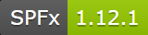
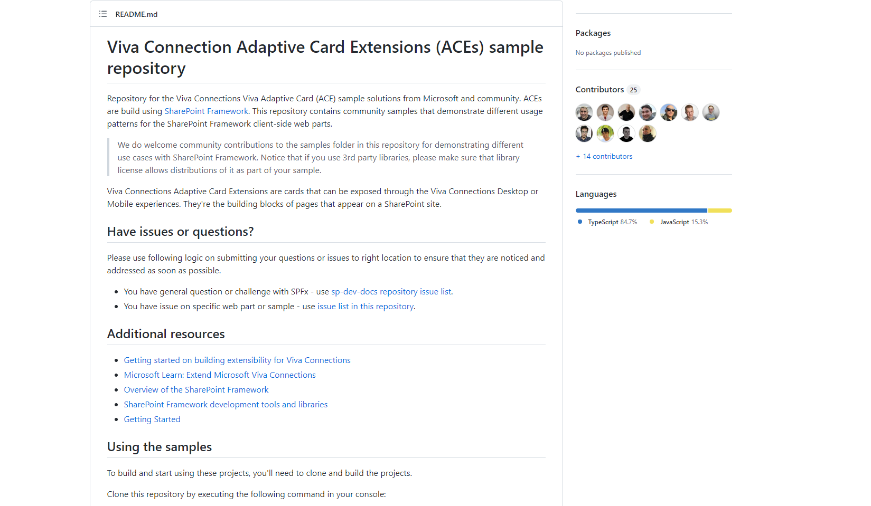
PnP SPFx ACEs
PnP SPFx Samples
PnP SPFx Samples
https://aka.ms/spfx-aces
*** We Love New Samples ***
Follow Documents André Lage | @aaclage
See all samples from https://aka.ms/m365/samples
Notes:
This is a sample how we can reuse graph client between ACEs from a different solutions. This can be quite handy especially if we implement batching strategy (as in this sample). Thanks to that requests from all ACEs can be batched together, which improves performance and overall end user experience

Slide 24




Optional picture time!
Video on and we’ll grab a Together Mode pic with those who are willing to do this.
We are together on this as a community!
Let’s all be like Seb?
By enabling your camera for the picture, you grant us permission to share your picture in social media.

Slide 25

DEMO
Getting started with SPFx form customizer – Ejaz Hussain
Building SPFx solution with Azure Communication Services integration – Hugo Bernier

Slide 26
Thank you!

Slide 27
Thank you
Recording will be available in 24 hours on
Microsoft 365 Community (PnP) YouTube channel
https://aka.ms/m365/videos
(subscribe today)
Follow us on Twitter
@Microsoft365Dev | @M365PnP
Next Viva Connections & SPFx call: September 22nd at 07:00am PT
Next M365 General Dev call: September 15th at 07:00am PT
All available community calls from https://aka.ms/m365/calls

Slide 28



aka.ms/m365pnp

